Slide 1
Designing Learner Centric MOOCs
Sahana Murthy
Indian Institute of Technology Bombay
AUA Online Education Conference
Beijing, July 5-6, 2019

Slide 2
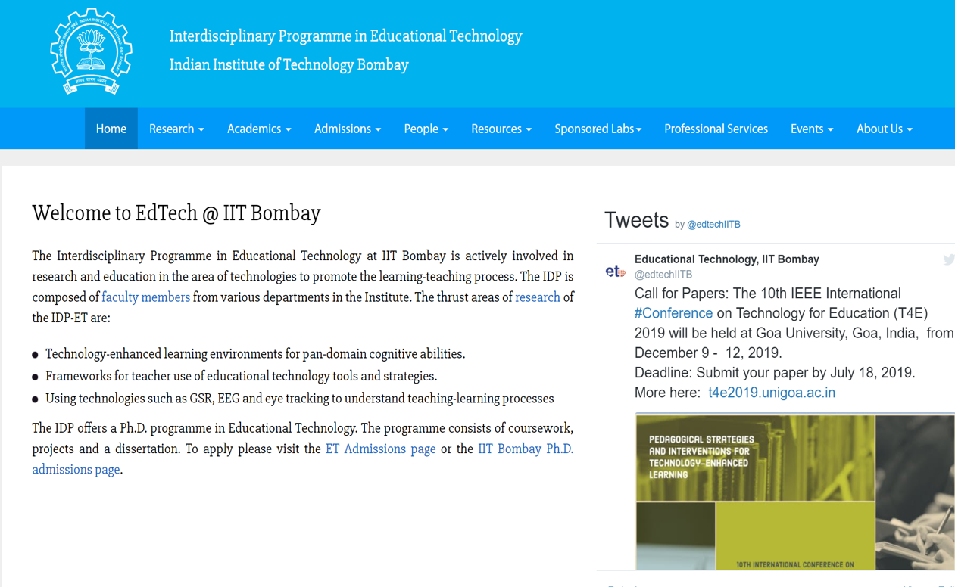
Educational Technology, IIT Bombay
www.et.iitb.ac.in

Slide 3
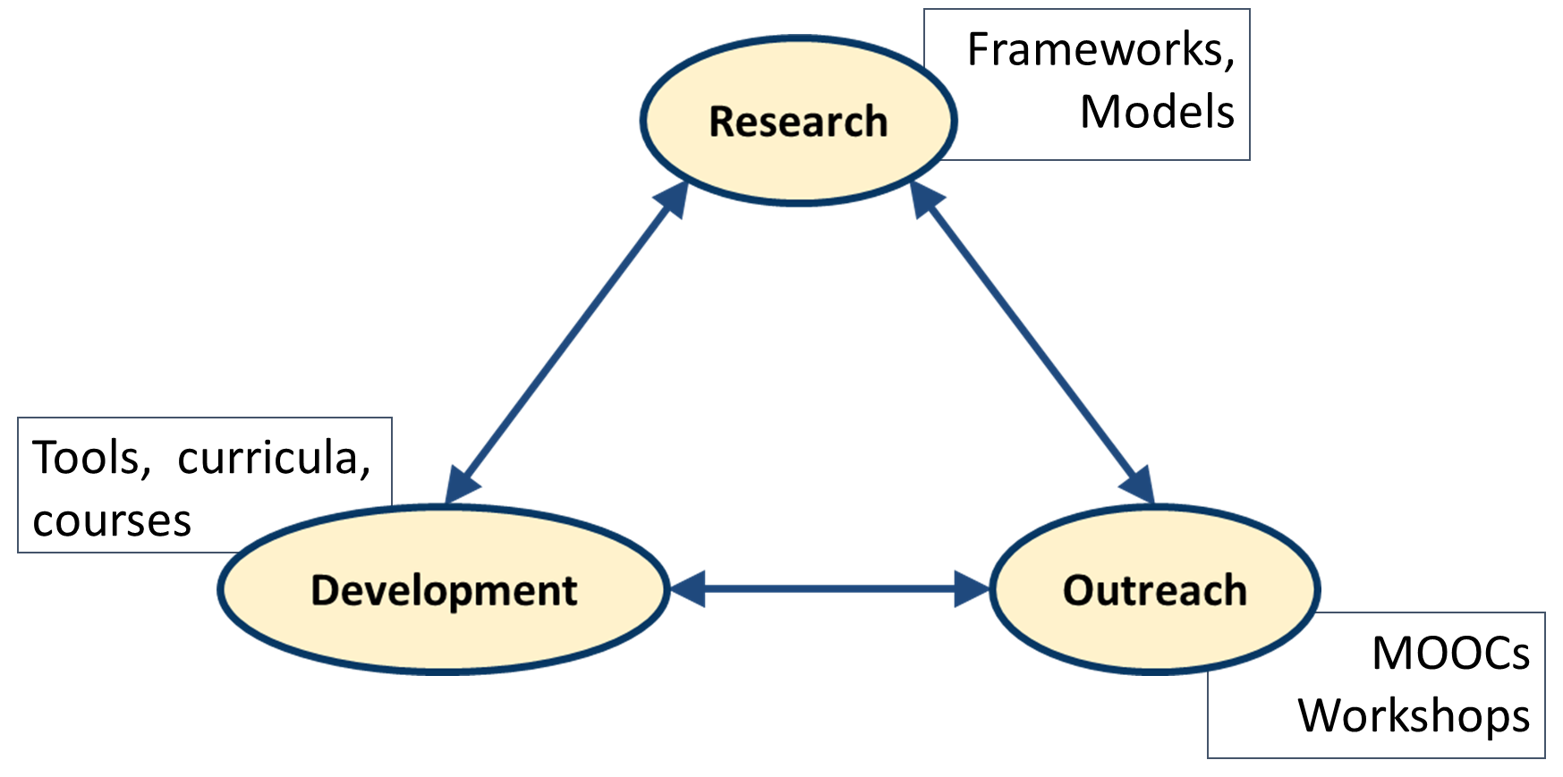
Teacher Use of Educational Technology (TUET)
Context - MOOCs
Faculty Professional Dev
This talk – How can instructors design and conduct their own
learner-centric MOOCs (without much difficulty)

Slide 4
MOOCs are ubiquitous, beneficial
Provide access to information anytime, anywhere
Technology platforms to support scale
Existing platforms - Coursera, FutureLearn, edX …
In India – IITBombayX, NPTEL/Swayam:
1500+ courses
40K+ hours of video
330M+ youtube views
Certification since 2014: 4.2million enrollments, 270000+ exam registrations

Slide 5
Is that enough?
A typical MOOC has lecture videos, exercises, discussion forums and assessment.
What’s missing?

Slide 6
What’s missing
Attention to learner motivation
Getting learners to express their reasoning
Opportunities for immediate micro-application
Formative assessment and instant feedback
Explicit activities to foster peer-learning
Ensuring learner connect during the MOOC
Established theories of How People Learn is missing

Slide 7
Known challenges
Funnel of participation (Clow, 2013)
Poor instructional design (Margaryan et. al., 2015)
Common MOOC problems may persist - low student engagement, low participation in discussion forums
Problems of engagement worsen in a MOOC setting - distance, scale and diversity of learners are all high

Slide 8
Need – Learner Centric MOOCs
Not sufficient to focus only on the technology features
Not effective to mimic a typical classroom
Need to help instructors:
Incorporate learner-centric approaches
using technology affordances

Slide 9
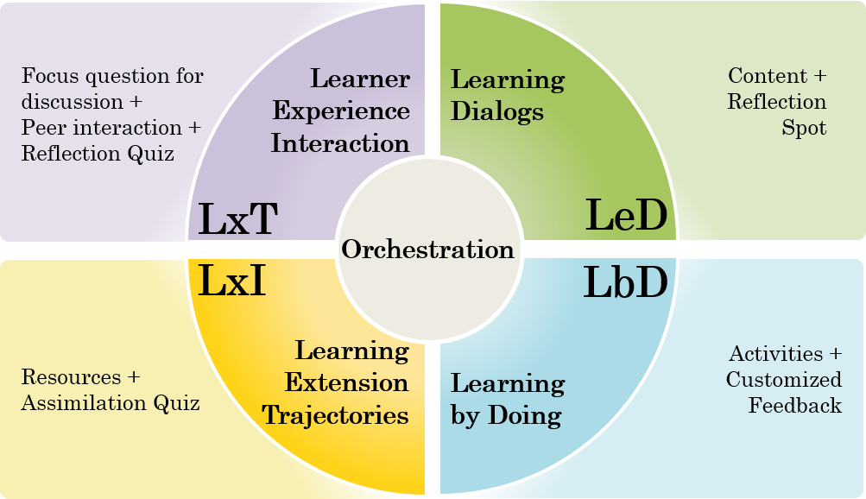
Learner-Centric MOOC (LCM) Model
Model for design and implementation of MOOCs with learner-centric basis

Slide 10
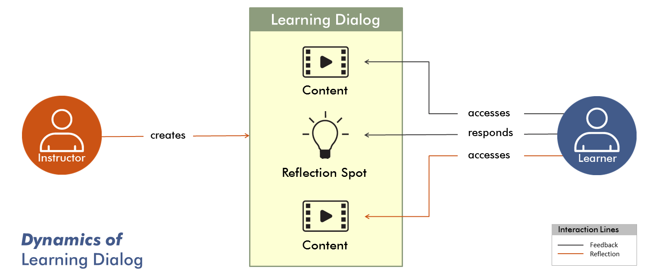
Learning Dialog (LeD)
Instead of videos, create Learning Dialogs
Include in-video Reflection Spots

Slide 11
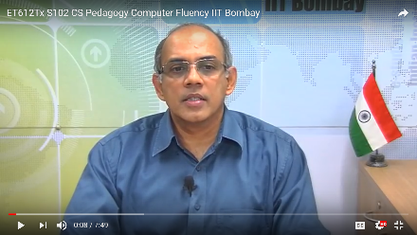
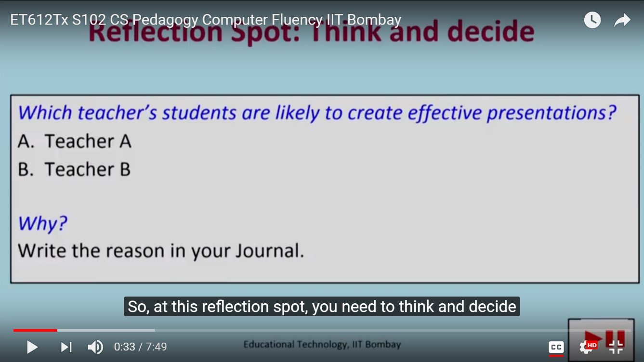
LeD Example in IITBombayX
Weblink

Slide 12
Research Evidence
Average retention rate in FDP101x:
LeD videos : 69.9%
Regular videos : 55.73%
Participants highlighted relevance and usefulness of LeD.
Drop-off in the first few minutes
One question per 8.7 minute increased engagement to 71-86%
(Cummins et. al., 2016)

Slide 13
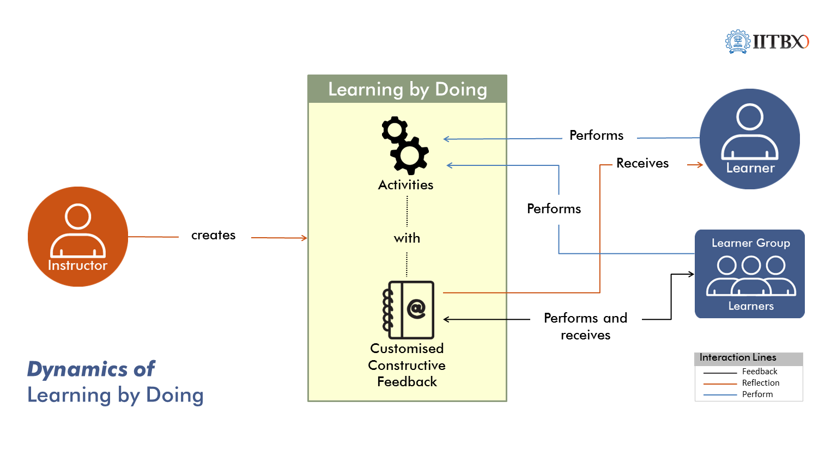
Learning by Doing
Intersperse LbD activities frequently
Give constructive customized feedback

Slide 14
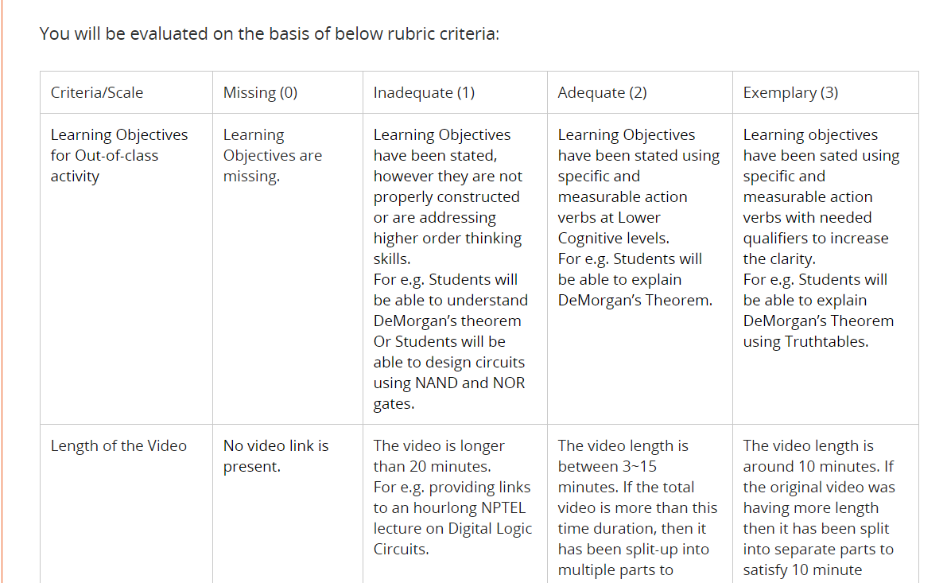
LbD Example in IITBombayX
LbD Activity:
Design a flipped classroom for a topic in your course.
Rubrics for peer-assessment
Link to course

Slide 15
Research Evidence
91.8% people found LbD activities useful [N=695]
“LbD activities and resource creation activities were very useful and regular practise of the same help a teacher to improve quality in teaching and learning process”
“ LeD and LbD helped me to understand the minute difference between standard practices and my own practice of lesson design.”

Slide 16
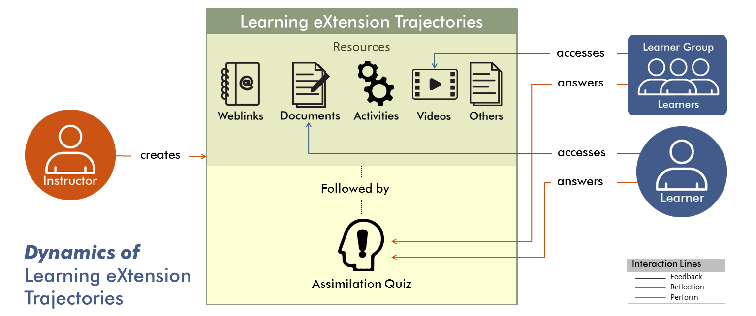
Learning Extension Trajectories (LxT)
Go beyond References:
Cater to diverse learners
Close the loop with Assimilation Quiz

Slide 17
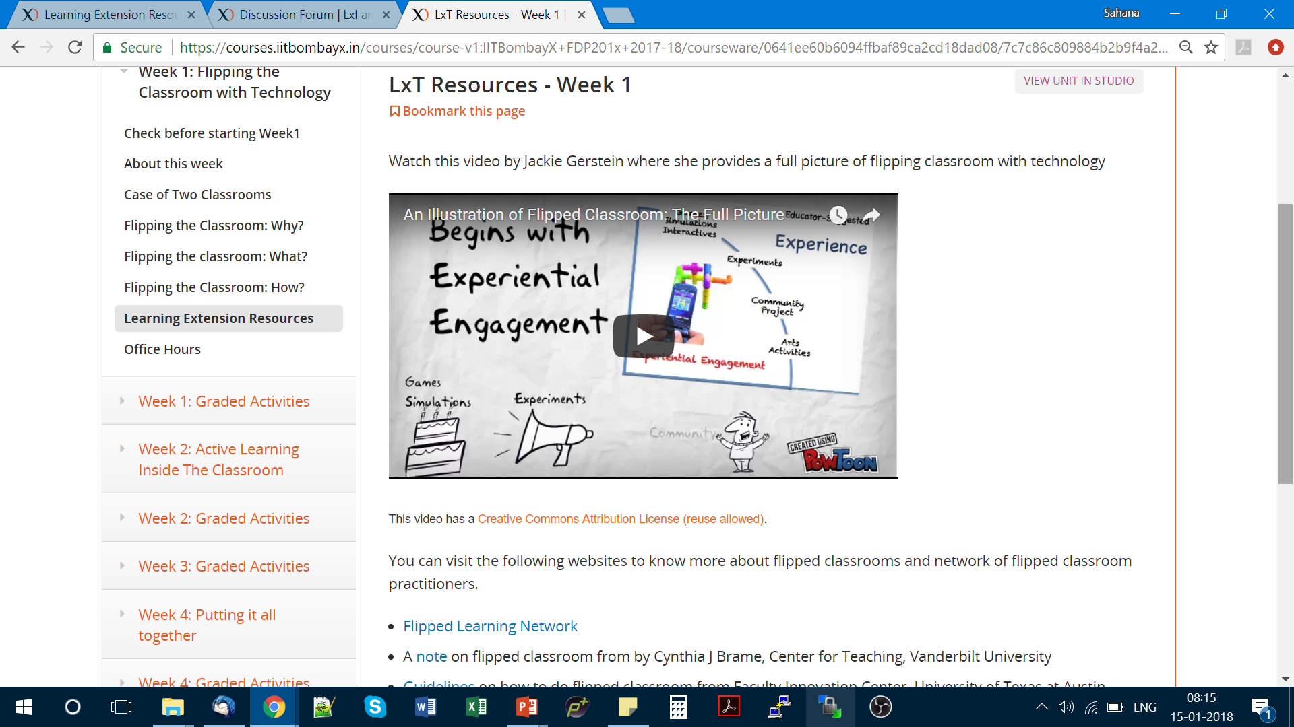
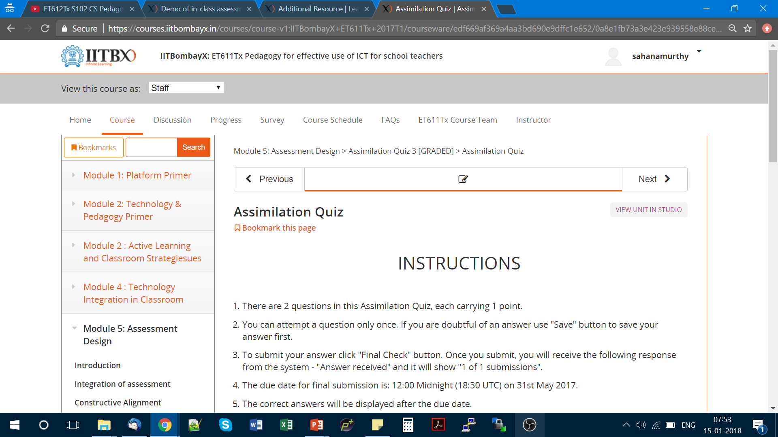
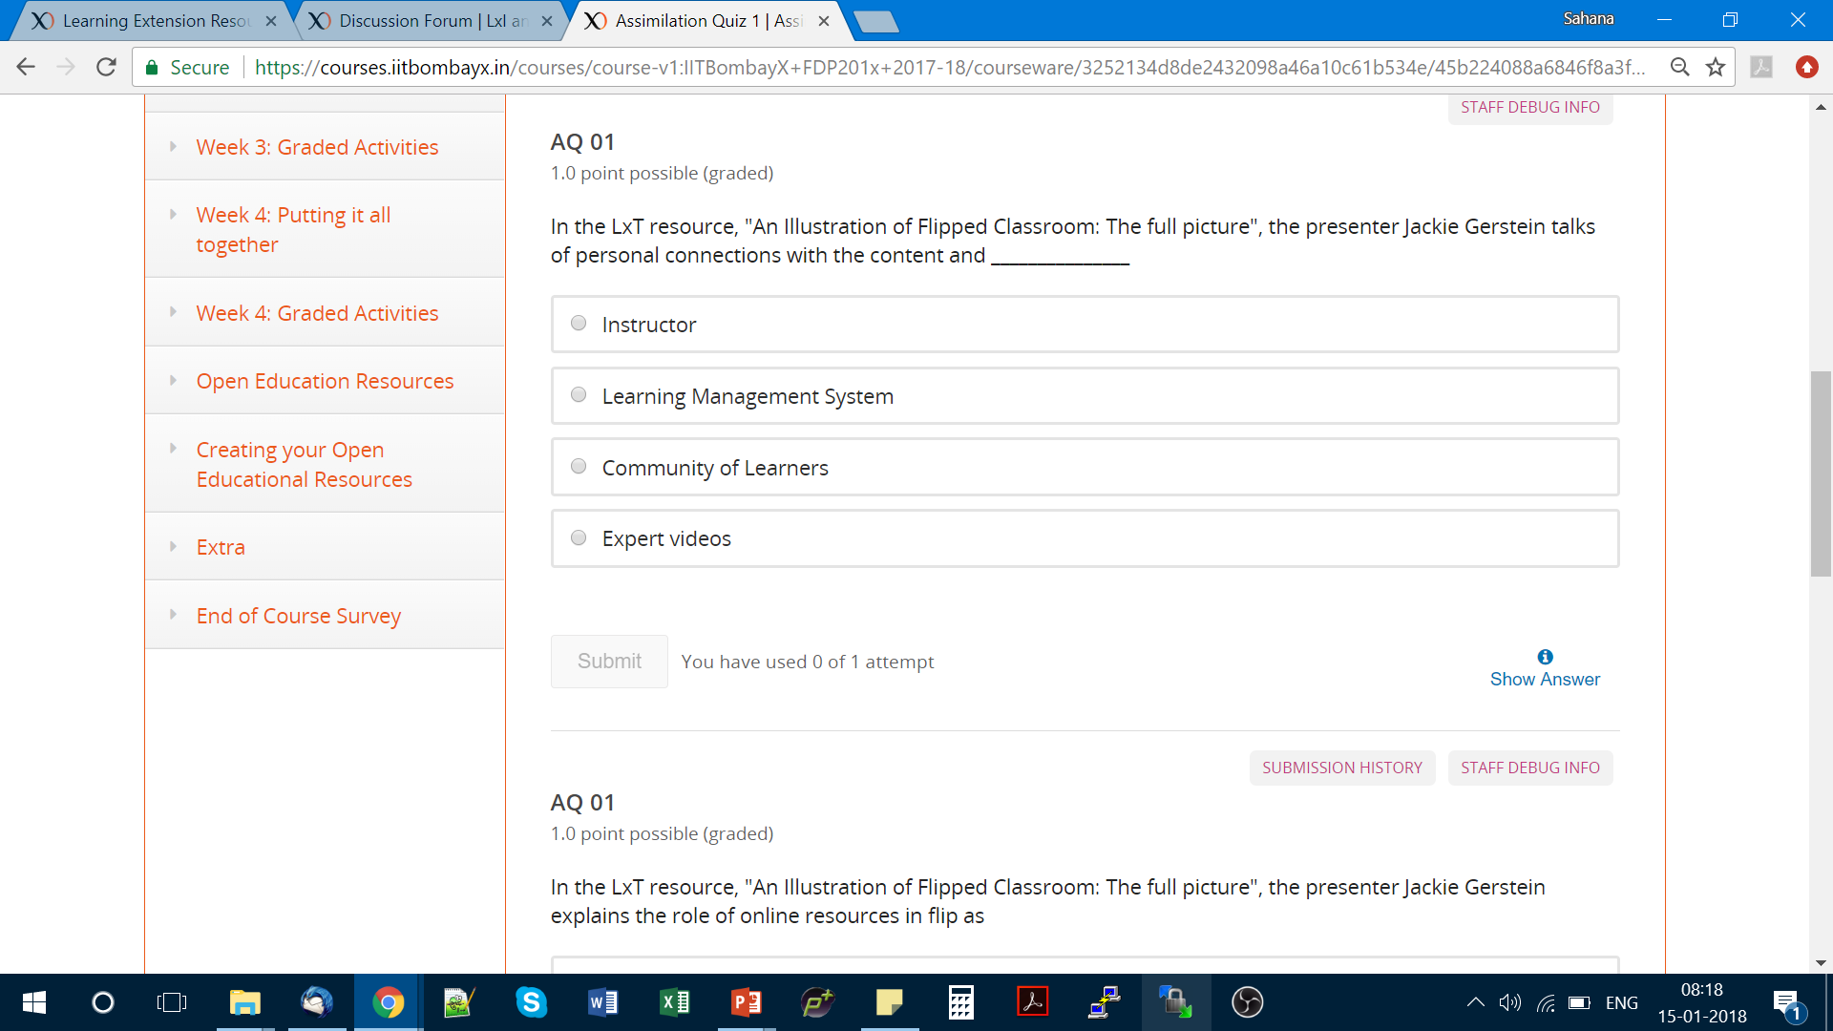
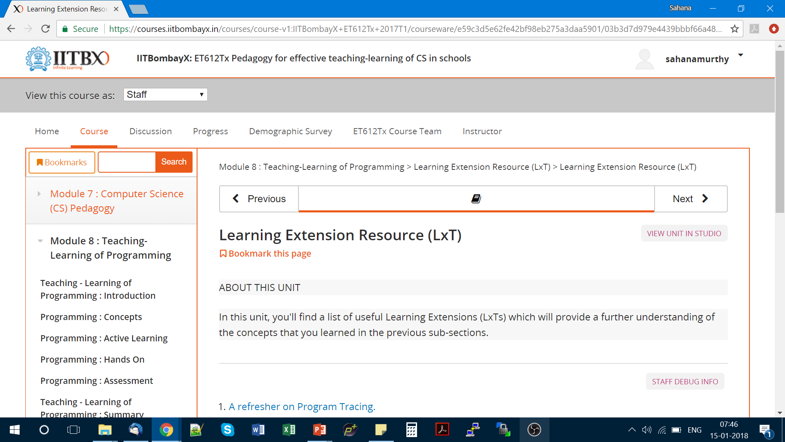
LxT Example in IITBombayX
Weblink

Slide 18
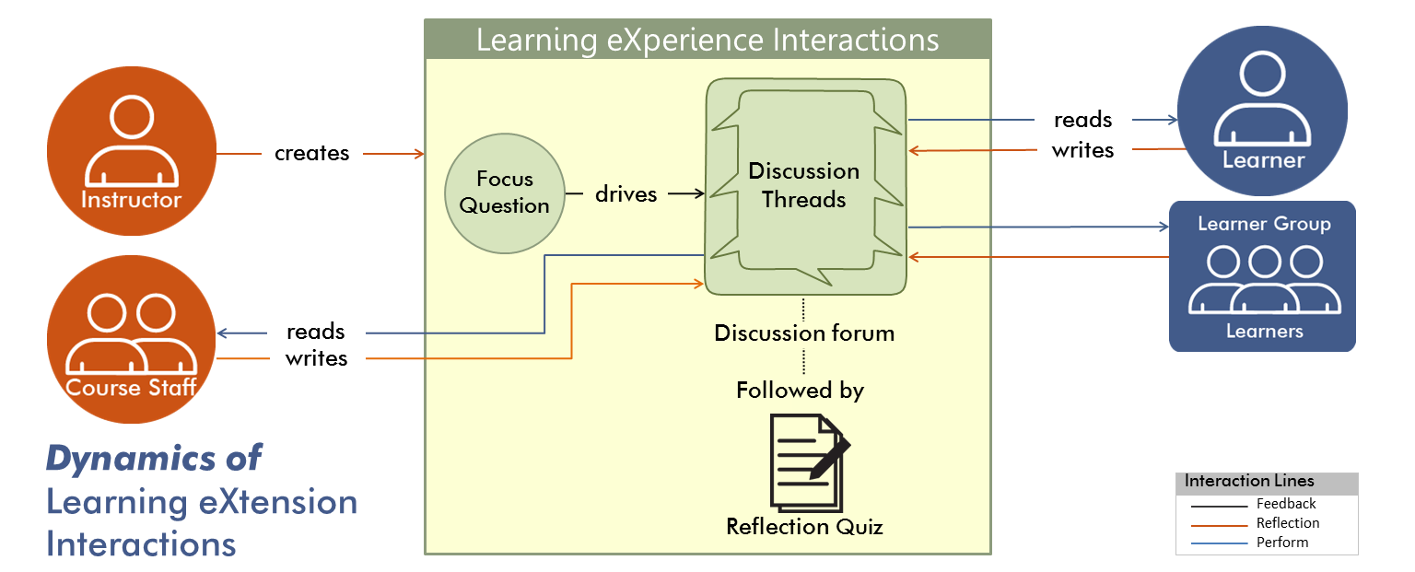
Learning Experience Interaction (LxI)
Go beyond Discussion forums:
Anchor discussions around focus question
Leverage peer learning, Incentivize with Reflection Quiz

Slide 19
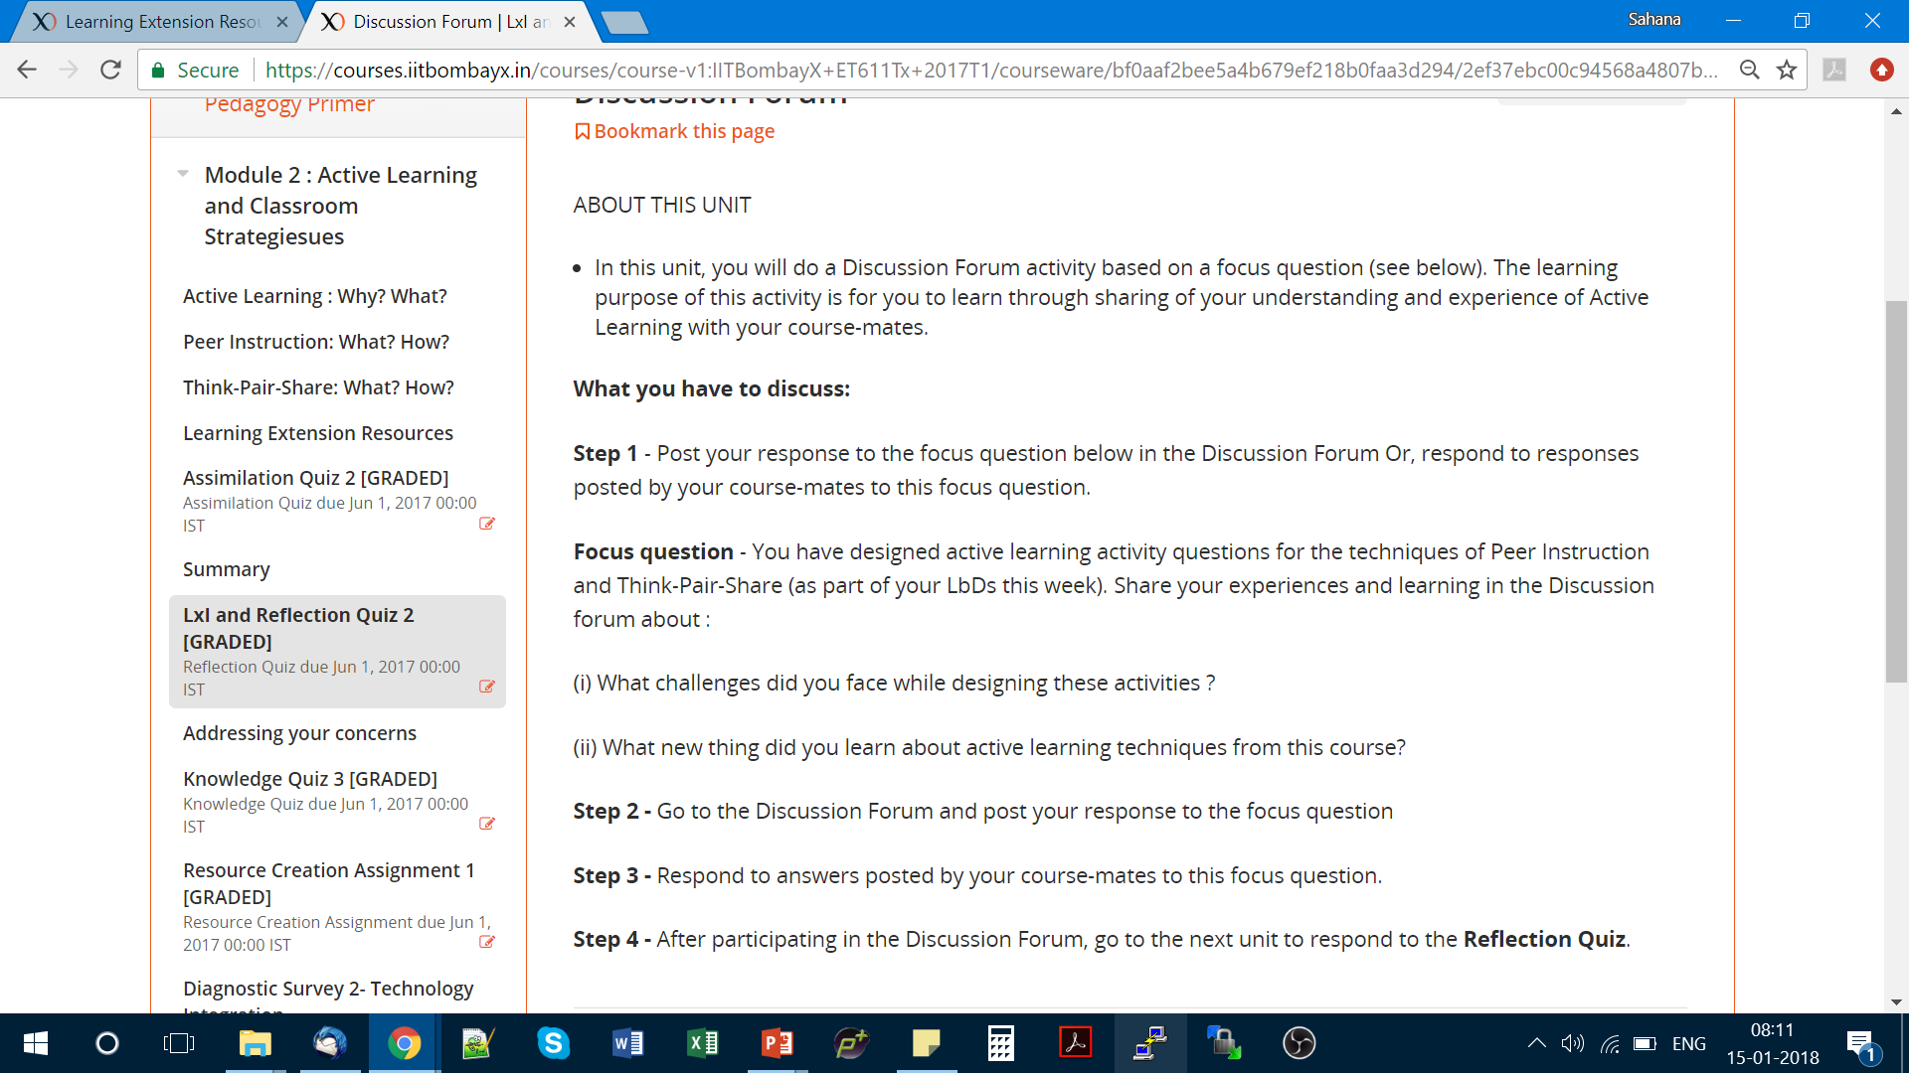
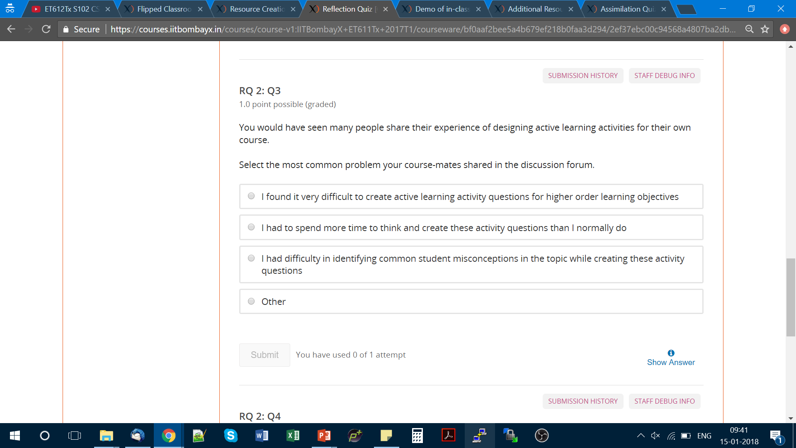
LxI Example in IITBombayX
Reflection Quiz
Reflection Quiz

Slide 20
Research Evidence
1691 active participants in the discussion forum
Total of 29355 posts across 8 weeks.
(Banerjee et. al., 2018)
“In your FDP, discussion forum is the best feature where I can interact with like minded teachers from institutes all over India. ”
“Discussion with other people about the subject, and TPS and PI activities are very interesting that motivated me a lot to complete the course.”

Slide 21
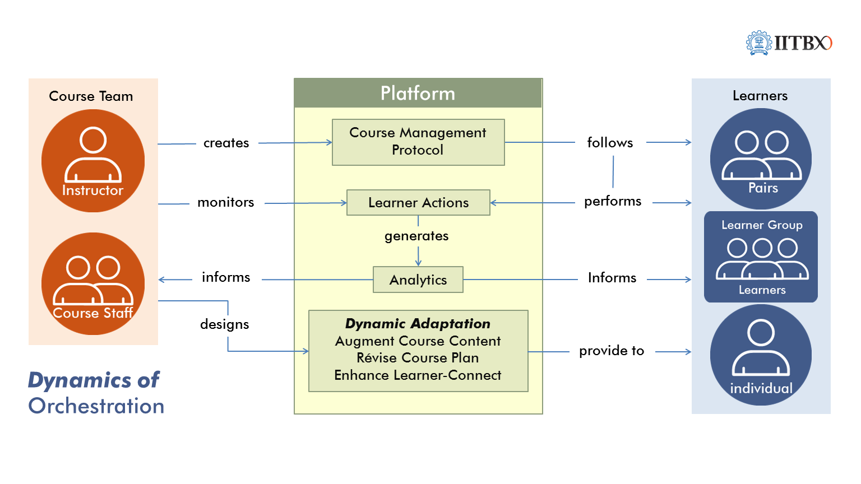
Orchestration
Do blended for learner connect
Exploit power of analytics to identify learner engagement and adapt course
Provide customized response to learner actions.

Slide 22
Overall Evidence
ET601Tx : Jan- Mar 2016, 5500 participants, engg instructors
Active participants: 67%
(participated in at least one activity)
Persistence rate: 37%
(completed all activities / active participants)
Completion rate: 23%
(completed all activities / registered participants)

Slide 23
What LCM model does
Guidance on designing and implementing learner-centred MOOCs
New pedagogical elements to be created, adapting existing elements
Guidance on what interactions to expect during MOOC
Student-Instructor, Student-Student
Focus on supporting instructor’s effort
Make MOOCs less daunting

Slide 24
A mapping from f2f scenario
f2f classroom scenario
Lectures and Demos
Assignments and Activities
Instructor-Learner interaction
Learner-Learner interaction
Additional Readings
Exams and Assessment
LCM Model
Learning Dialogues (LeD)
Learning by Doing (LbD)
Response and Feedback (RF)
Learning experience Interactions (LxI)
Learning extensions (LxT)
Knowledge Consolidation (KC)

Slide 25
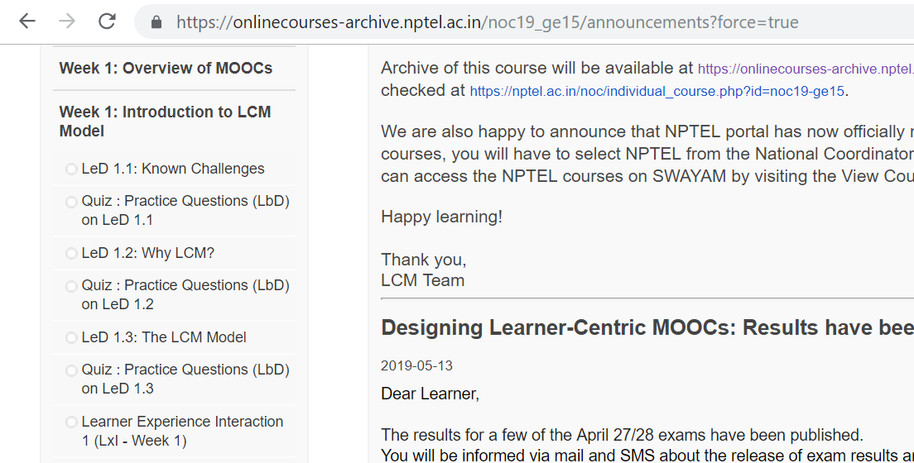
Implementation of LCM model
Courses:
Effective teaching & learning CS in Schools
Foundation Program in ICT in Education
Pedagogy for Online and Blended Learning
Basic 3D Animation using Blender
Screenshot of course on NPTEL platform

Slide 26
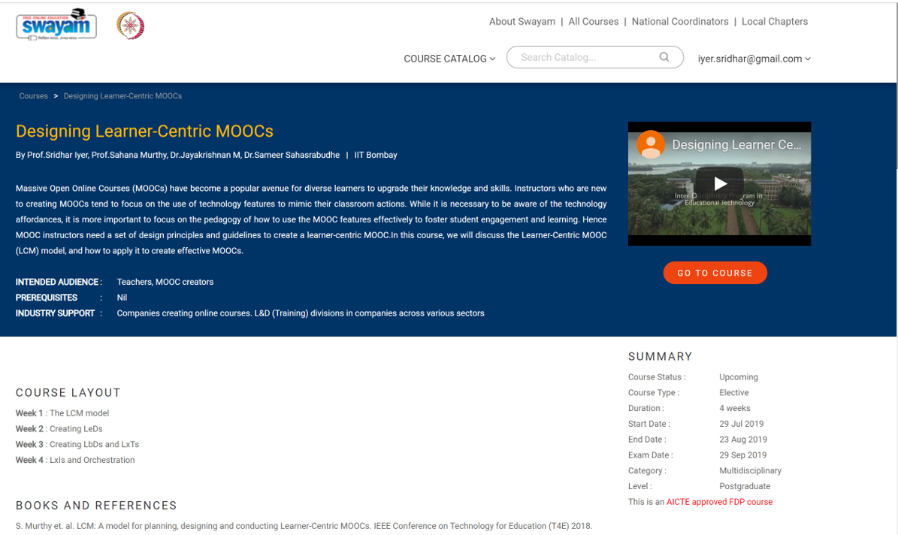
More on LCM

Slide 27
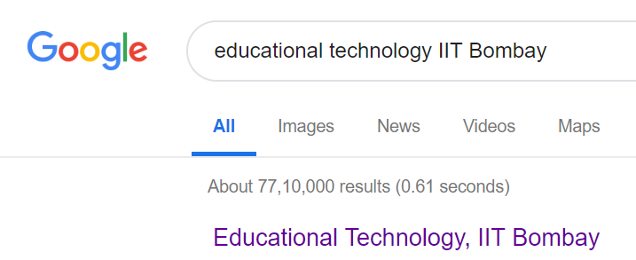
THANK YOU
For more info:
www.et.iitb.ac.in
sahanamurthy@iitb.ac.in

